Slide 1

ALGORITHMIC FAIRNESS
FINANCE AND HEALTHCARE

Slide 2
AGENDA
01
04
Fairness in Health
Fairness in Finance
02
Detecting bias in dataset
05
Mitigating bias in classifiers
03
Mitigating age bias on credit decisions
06
Data interpretability using LIME

Slide 3

LOL-GORITHM: DENIED BY THE VOWEL POLICE!
Me and my friend, with identical financial backgrounds, apply for credit cards. The algorithm decides my fate based on an unexpected factor: the number of vowels in your names. my friend, Ram, gets approved, but me, with a longer name, get denied. Turns out, algorithms can be a real "consonant conspirator"!

Slide 4
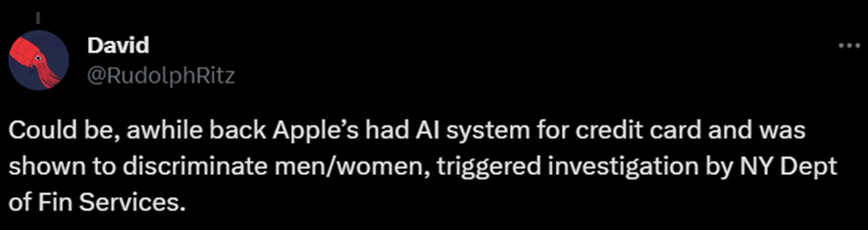
APPLE CARD CREDIT LIMIT CONTROVERSY
Apple Card faced criticism for alleged gender bias in credit limits
“My wife and I filed joint tax returns, live in a community-property state, and have been married for a long time,“Yet Apple’s black box algorithm thinks I deserve 20x the credit limit she does.”

Slide 5

USE OF ALGORITHMS IN FINANCIAL SERVICES
Automated credit scoring and decisioning
Automated pricing
Real-time fraud detection

Slide 6
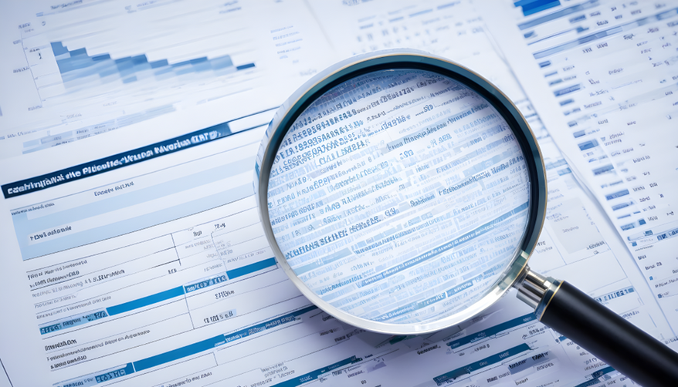
FACTORS IMPACTING ALGORITHMIC BIAS
There are several factors that can lead to algorithmic bias. The main factors include:
Biases in data
Biases in algorithmic design
Biases in human use.

Slide 7
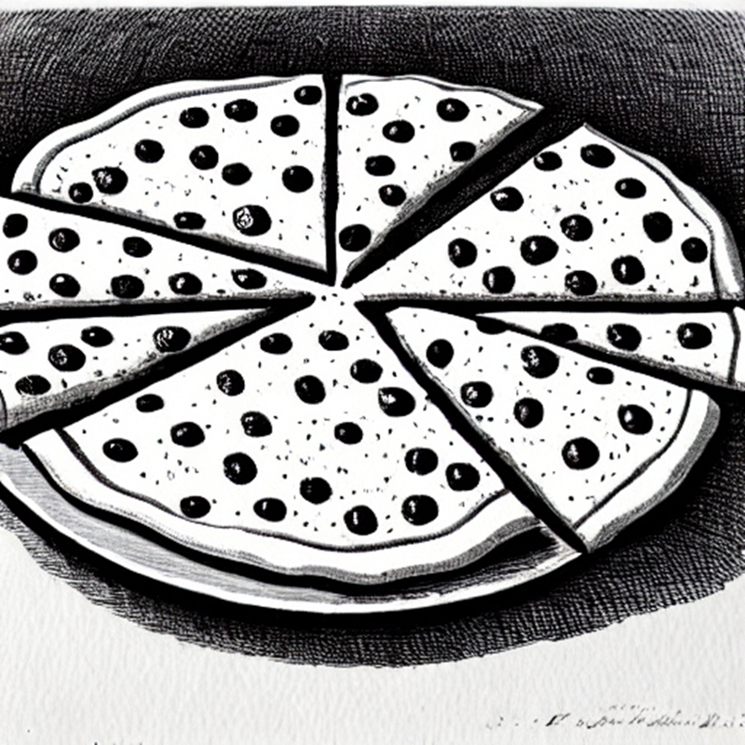
PIZZA BIAS: WHEN DATA CHEESES OUT!
Think of data like a pizza. Bias is like putting way more cheese on one slice than the others. It's not fair for all the slices, and that's how bias in data works—some parts get more attention than they deserve. Let's aim for a balanced topping distribution!

Slide 8
DETECTING AND MITIGATING AGE BIAS ON CREDIT DECISIONS
MITIGATION STRATEGIES
step 1:
Set bias detection options, load dataset, and split between train and test
Data defining
Data gathering
Data labelling
Data pre-processing
Step 2:
Compute fairness metric on original training dataset
Step 3:
Mitigate bias by transforming the original dataset
Step 4:
Compute fairness metric on transformed training dataset

Slide 9
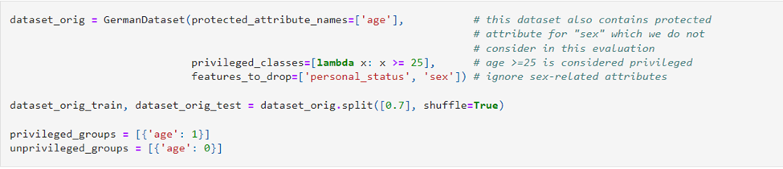
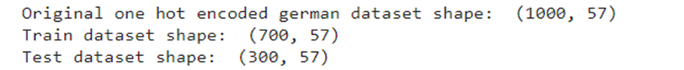
DATA PREPROCESSING
Step 1
Step 2
Step 3
Load the German credit card dataset
Specify the protected attribute
split dataset into train and test datasets

Slide 10
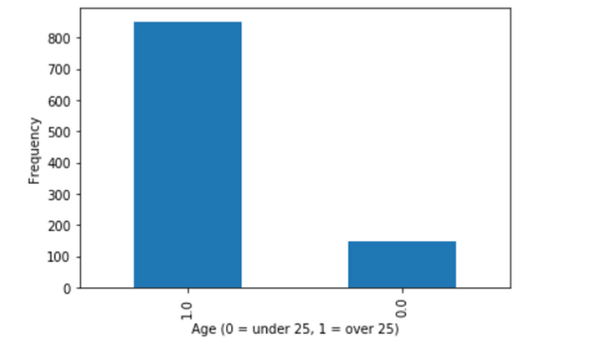

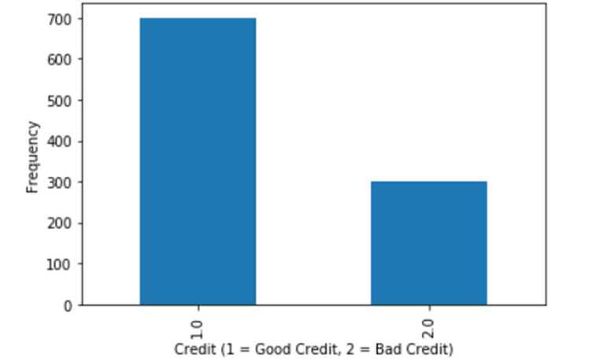
BIAS IN DATASET
COMPUTING FAIRNESS METRIC
Disparate Impact
Computed as the ratio of rate of favorable outcome for the unprivileged group to that of the privileged group. The ideal value of this metric is 1.0.

Slide 11
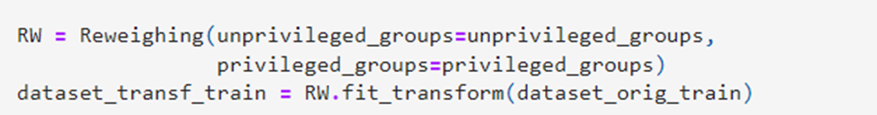
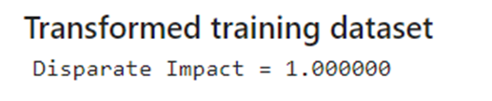
DATA TRANSFORMATION
Package used: aif360.algorithms
Algorithm: Reweighting
Bias mitigation technique: Data preprocessing
Reweighting algorithm transforms the dataset to have more equity in positive outcomes on the protected attribute for the privileged and unprivileged groups.
FAIRNESS METRIC

Slide 12
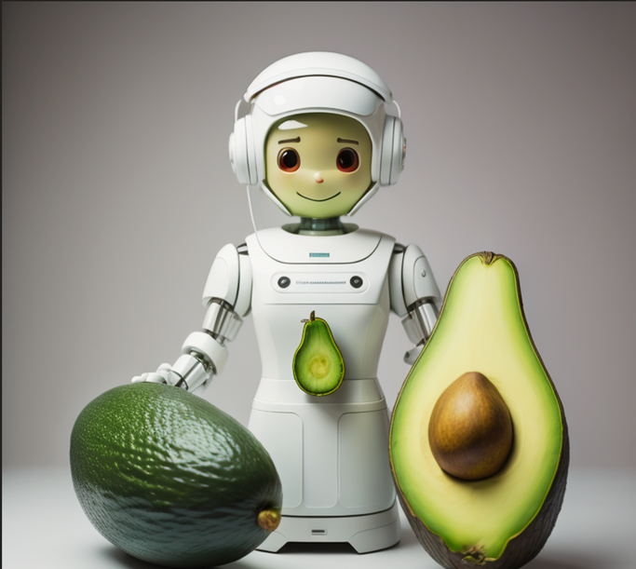
THE AI NURSE
The AI Nurse, an Avocado Advocate, Keeps Recommending Guacamole for Every Ailment, Ignoring Other Food Preferences. Patients Wonder if Avocado Toast is the Universal Cure!

Slide 13
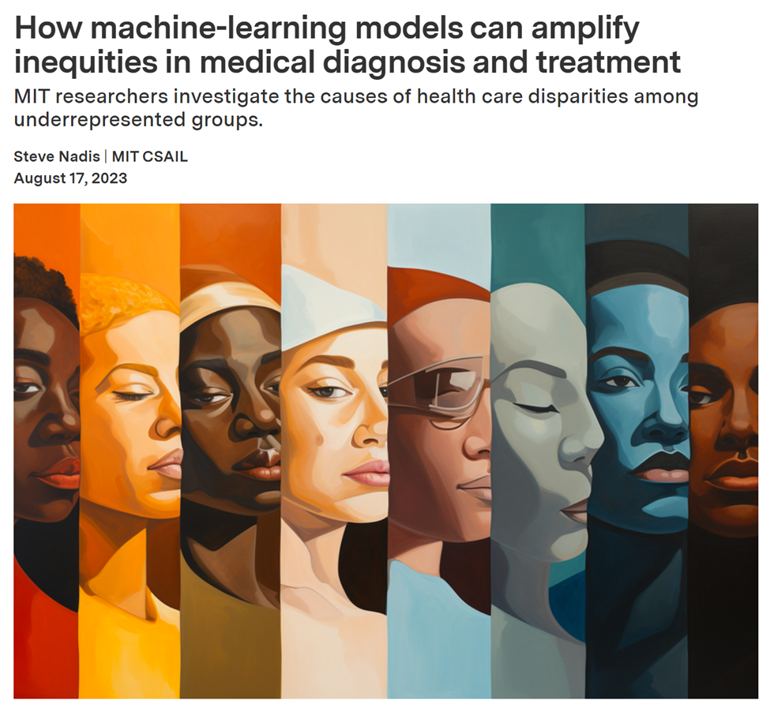
NAVIGATING FAIRNESS IN DIAGNOSES

Slide 14
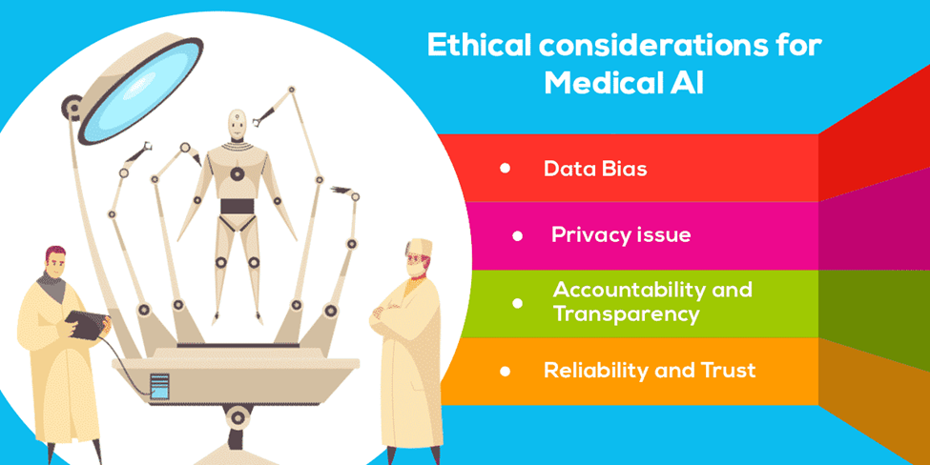
ETHICAL CONCERNS IN AI HEALTHCARE
Artificial Intelligence (AI) holds great promise in transforming healthcare, but it also raises ethical concerns that demand careful consideration.
We are focusing on mitigating bias in our heart attack prediction model, recognizing the importance of fair and unbiased predictions for patient well-being.
By implementing techniques such as SMOTE and post-analysis with LIME, we aim to enhance the fairness and interpretability of our AI model.

Slide 15
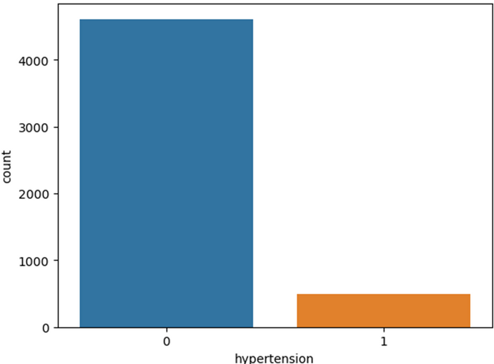
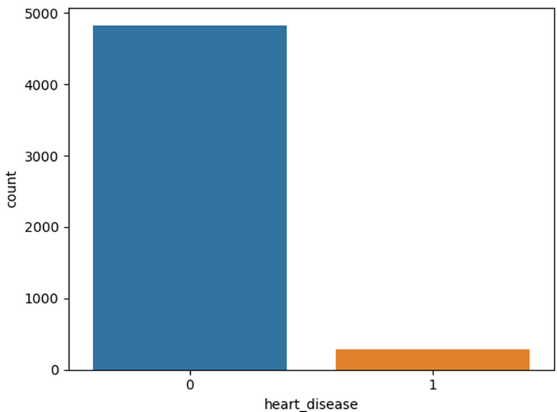
DATA OVERVIEW
Dataset: Healthcare-dataset-stroke-data
Key Parameters:
id
gender
age
hypertension
heart_disease
ever_married
work_type
Residence_type
avg_glucose_level
bmi
smoking_status
stroke

Slide 16
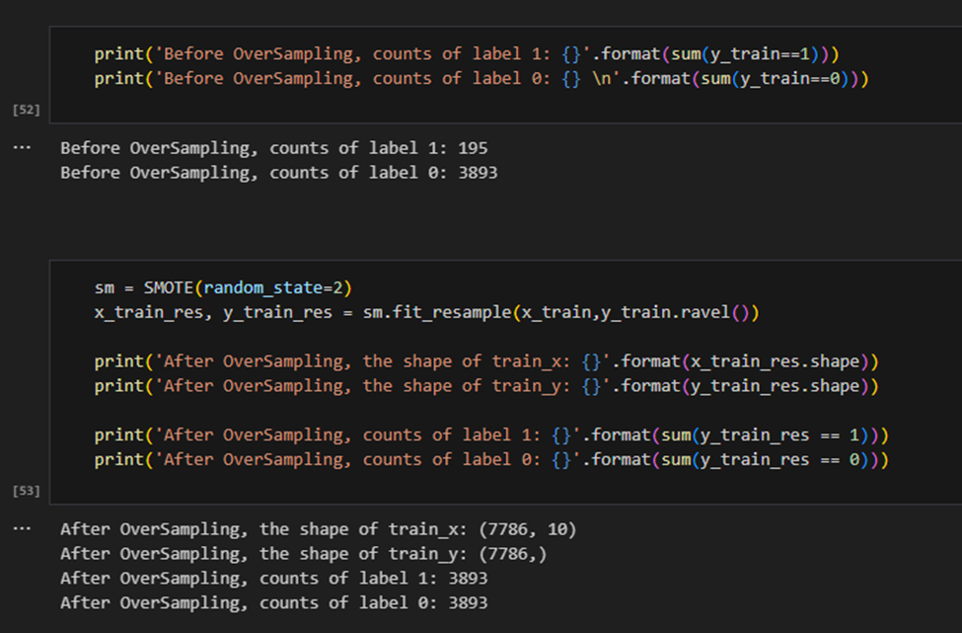
SMOTE - SYNTHETIC MINORITY OVER-SAMPLING TECHNIQUE
SMOTE is a resampling technique designed to balance class distribution by generating synthetic instances of the minority class.

Slide 17
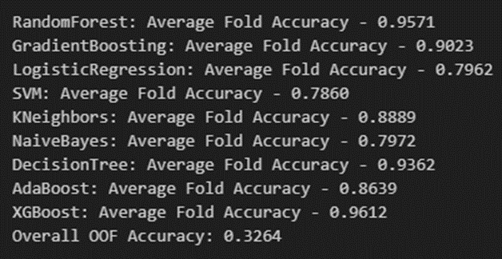
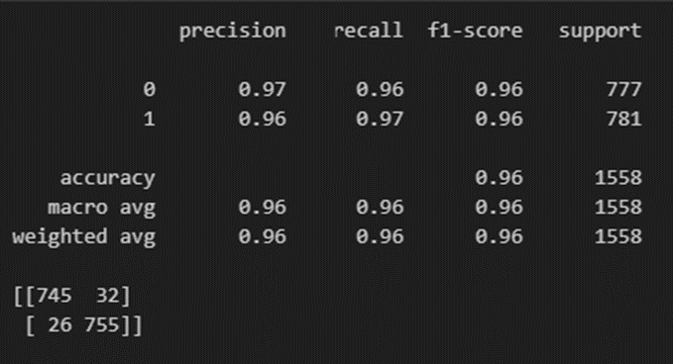
RESULTS
RandomForestClassifier

Slide 18
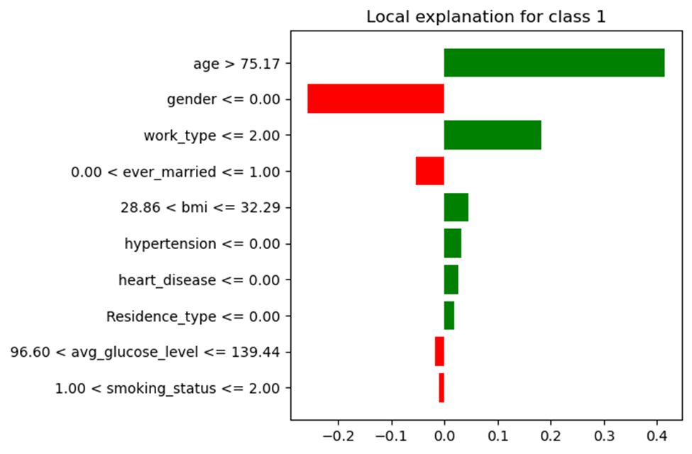
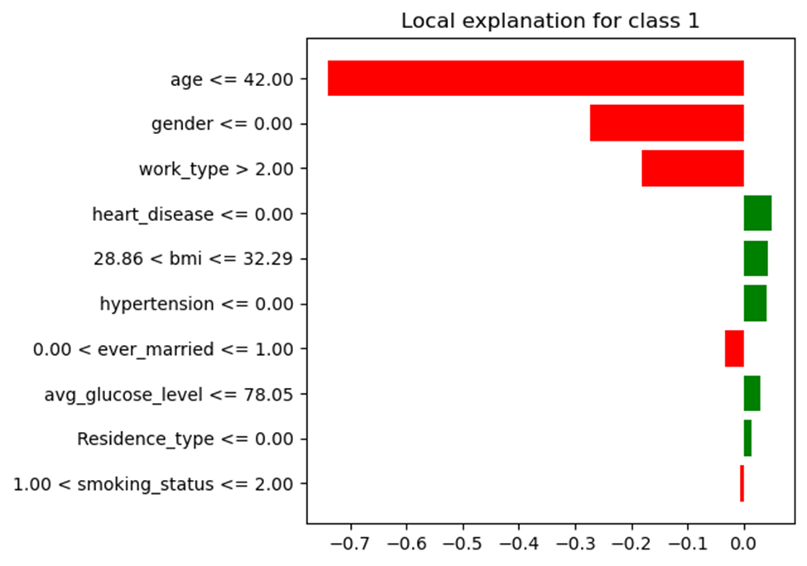
LIME - LOCAL INTERPRETABLE MODEL-AGNOSTIC EXPLANATIONS

Slide 19
CONCLUSION
As AI technologies advance, the increasing ethical concerns directly impact human trust.
We emphasize the importance of concurrently advancing ethical considerations to ensure the development of safe and transparent AI models in the future.

Slide 20


